Slide 1
Intro to AI in Medicine
Lec 16: Interactive Case Study

Slide 2
Last time
Discussed AI Superintelligence
AGI vs Superintelligence
AI Singularity
Talked about alignment issues in modern day and how they might translate to issues with a rogue AI (Paperclip problem)
Arvind guest lecture about working at Doximity

Slide 3

Today
Interactive Scenario

Slide 4
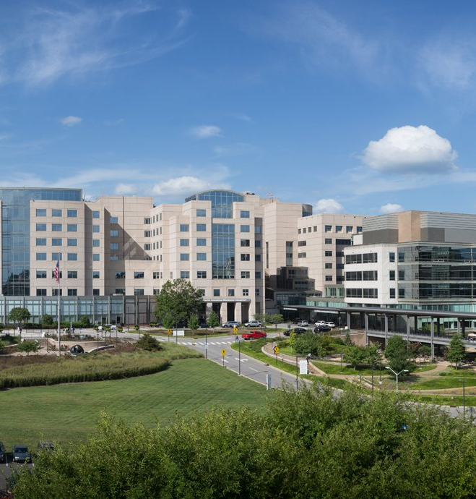
Background
You and 3-5 other physicians from various disciplines are on the AI rollout committee at UNC Hospitals
UNC received a $15 million grant to be the first hospital to roll out a suite of AI related diagnostics
However, two weeks in things aren’t going so smoothly
You have to take in all the info, and come up with a decision to present to the Chief Medical Information Officer (CMIO)

Slide 5
Workflow
You’ll first have 5 min in breakout rooms to look over the documents.
Then, stakeholders will pop into your room for 7 min at a time. They work with a different aspect of the system everyday, so by asking them questions you can learn about things working well or not so well
At the end, you have 5 min to think before giving a presentation to the CMIO (me)

Slide 6
Three Key Stakeholders
James Adams: Engineering lead at Oracle Healthcare
Eduardo Canto: UNC Hospitalist
Sam Alberto-Fernandez: Patient in the ED that just got admitted
More info on all these people in your handout

Slide 7
Let’s Cook!

